Slide 1
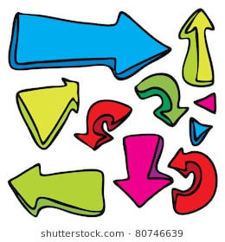
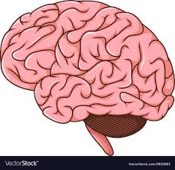
Transforming thoughts in actions
Team 12: ChemeHack
Intra- and inter-area neural computations that lead to movement
Hmmmm….

Slide 2
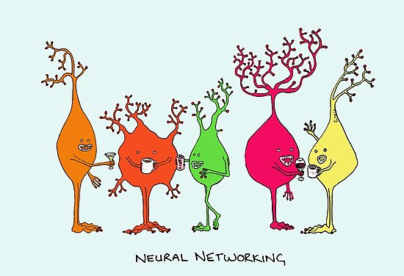
Neurons and activity
Electrically excitable cell that receives, processes, and transmits information through electrical and chemical signals
Neurons connect to each other to form neural network
Rate of firing of neurons depends on activity
Each activity activates different part of brain

Slide 3
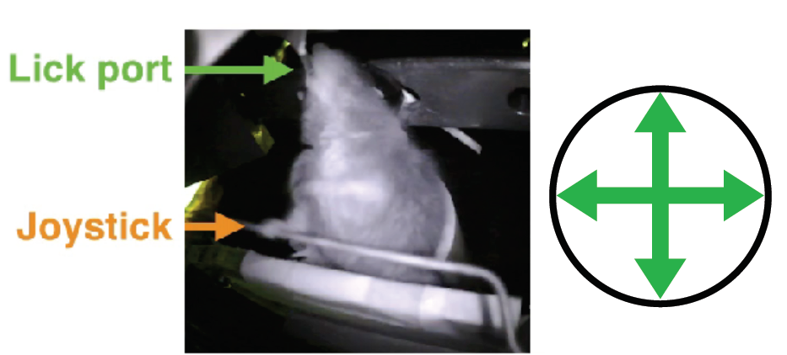
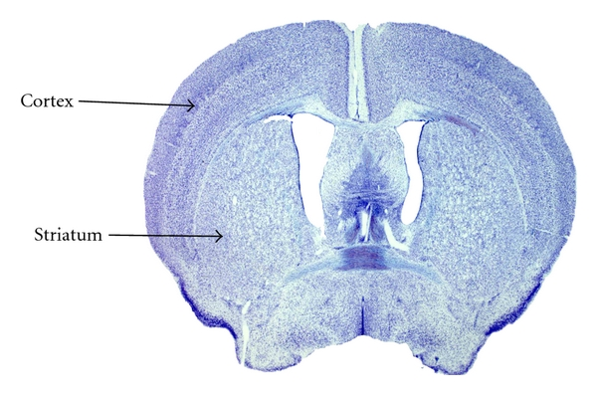
“Yttri” Dataset
Neuron Timestamp
Neuron Location
Movement Timestamp
Joystick Position

Slide 4
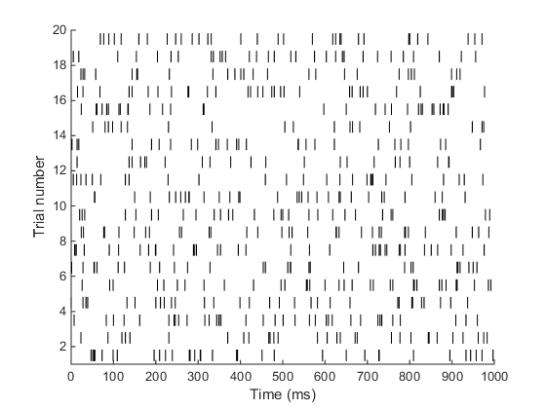
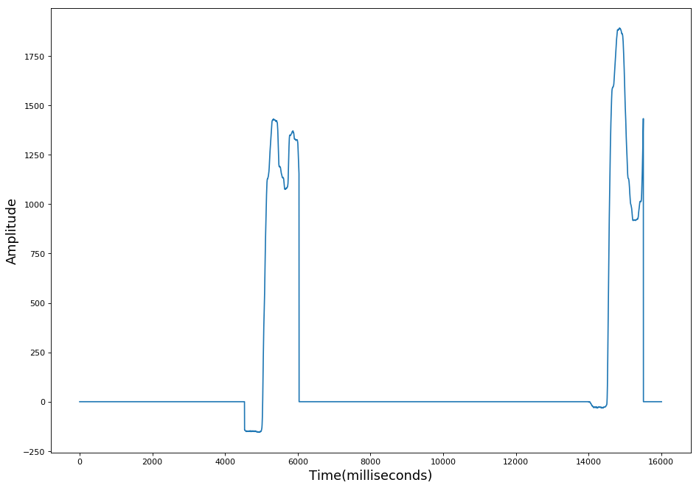
Feature Extraction
Reaches Data (Movement)
Movement
Non-Movement
Time (ms)

Slide 5
Feature Extraction (Movement windows)
Reach Identifier | Start Time (in ms) | End Time (in ms)
1 | 4953 – 500 = 4453 | 4953 + 1000 = 5953
2 | 14008 | 15508
. | . | .
170 | 1864900 | 1866400
Reaches
1 | 2 | 3 | . | . | 170
4953 | 14508 | 24614 | . | . | 1865400
Activation time of all neurons
Neuron Identifier | Time (in ms)
1 | 178.7 | 633.5 | 654.37 | . | . | .
2 | 776.630 | 4193.9 | 4657.4 | . | . | .
. | . | . | . | . | . | .
385 | 81.033 | 172.4 | 183.4 | . | . | .

Slide 6
Feature Engineering
Neuron labels
Feature matrix
Output Class Labels
Reach Number
 | 1 | 2 | . | 385
1 | X_{1_1} | X_{1_2} | . | X_{1_385}
2 | X_{2_1} | X_{2_2} | . | X_{2_385}
3 | X_{3_1} | X_{3_2} | . | X_{3_385}
. | . | . | . | .
. | . | . | . | .
. | . | . | . | .
2*n | X_{2*n_1} | X_{2*n_2} | . | X_{2*n_385}
1 → Movement occurs
0→ No Movement
Y₁
Y₂
Y₃
.
.
.
Y_{2*n}

Slide 7
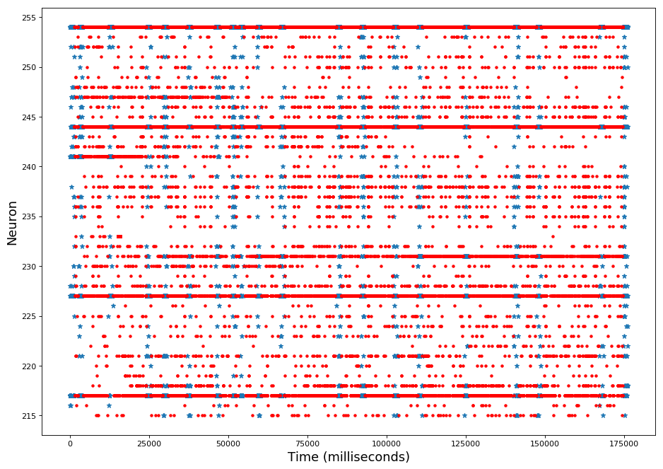
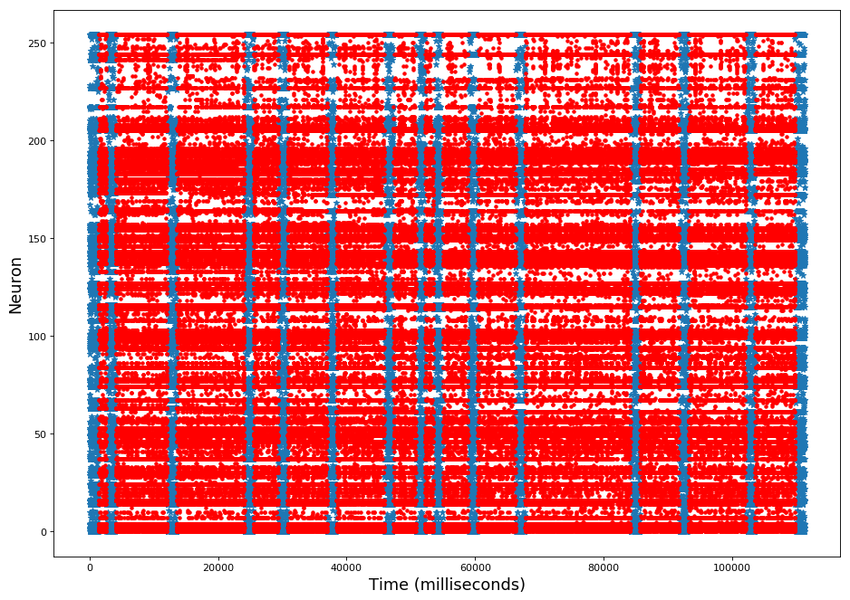
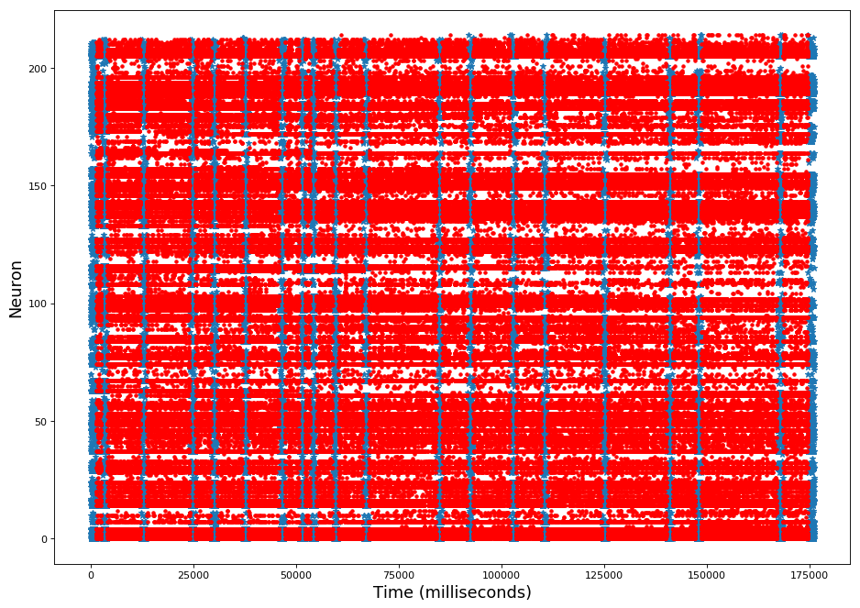
Neurons fire pattern
Cortex Neurons
Striatum Neurons

Slide 8
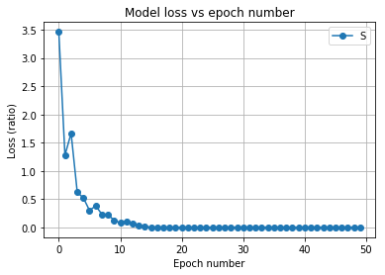
Model loss and accuracy
Model characteristics
Neural Network
Input 385
1 Hidden layer
100 Hidden Units
ReLU activation 1st layer
Sigmoid activation 2nd layer
92.22% (Test accuracy)
3/7 (Test to Train ratio)

Slide 9
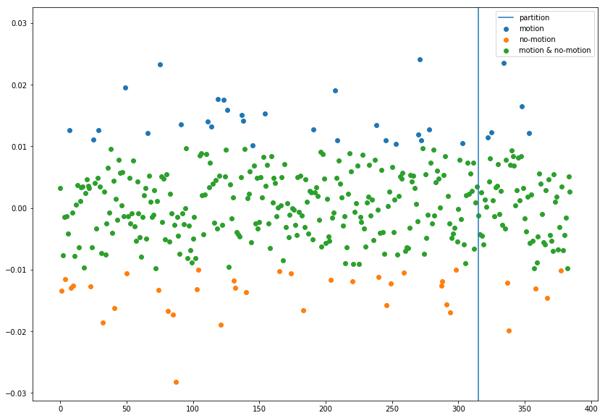
Neuron weights in Neural Network
Striatum motion neuron density: 0.0849
Cortex motion neuron density: 0.0746
Neuron weights
Striatum
Cortex
Neuron Number

Slide 10
Conclusion
Predict action behavior using neuron firing
Cluster neurons activity/no activity
Cortex firing density is lower than striatum firing

Slide 11


Future work
Relating neuron firing to multidirectional movement
Influence of rewards on action
Effect of long term memory on behavior

